Slide 1
Akhuwat Interest Free Microfinance (Qarz-a-Hassan – An Alternate Paradigm
Junaid Farid
Director, Strategic Planning & International Marketing

Slide 2
Microfinance
Microfinance is the provision of financial services to the poor on the basis of social collateral. These services include:
Microcredit
Micro Saving
Micro Insurance
Micro Leasing

Slide 3
Need for Microfinance
Financial Inclusion
Poverty Alleviation
Women Empowerment
Promoting entrepreneurship
Social Development
Notes:
2B, main objective, earn save and other services
MDG
Economically marginalized
Centre, change social institutions

Slide 4
Why an alternative paradigm is needed
Interest Based Lending @ high cost 25 - 60% or even more
Loans to Women only
Product not necessarily suited to the borrower’s need
Shift from NGO domain to banks – business/ industry
Focus on organizational sustainability only

Slide 5
Akhuwat
Qarz-a-Hassan (Interest Free Loans – An alternative Paradigm)
An attempt to resolve most of these issues through innovation

Slide 6
History
Akhuwat was established in 2001 with the objective of providing interest free micro-credit to the poor so as to start a business, come out of poverty and enhance their standard of living. Subsequently it added education, health, clothing and some other services in its mandate
‘Akhuwat’ means solidarity with the poor and less advantaged.

Slide 7
Inspiration
Inspired by the spirit of sharing & compassion.
The event of Muakhaat e Madina
Muakhat is a philosophy and way of life not merely an isolated event.
Notes:
Add vision

Slide 8
Core Principles
Interest Free Loans
Use of Religious Centers
Spirit of Volunteerism
Transforming Borrowers into Donors
No Discrimination on the basis of Caste, Color, Creed, Political Affiliation & Faith

Slide 9
Products
Enterprise Loan
Liberations Loan
Agricultural Loan
Education Loan
Marriage Loan
Emergency Loan
Housing Loan
Establishment of School Loan

Slide 10
FEW PHOTOGRAPHS OF BORROWERS

Slide 11
Akhuwat Borrower

Slide 12
Akhuwat Borrower

Slide 13
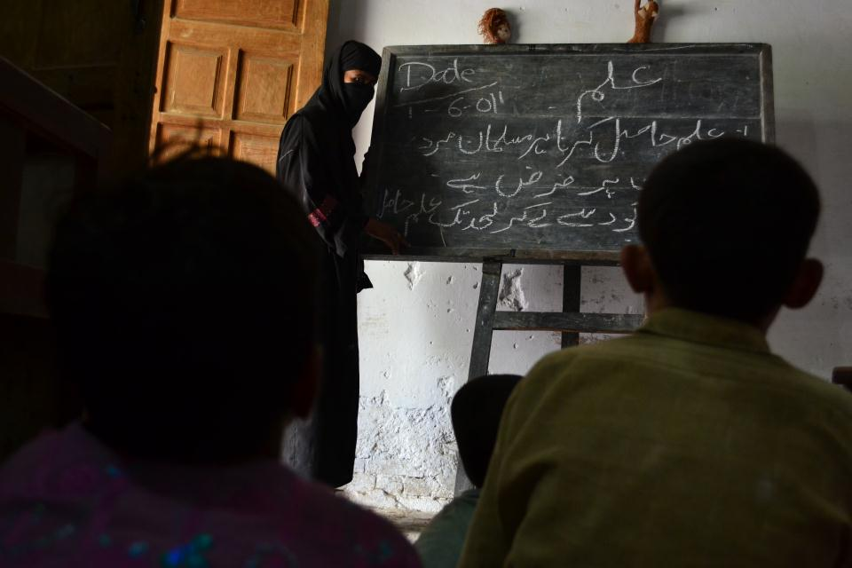
Akhuwat Borrower

Slide 14
Akhuwat Borrower

Slide 15
Akhuwat Borrower

Slide 16
Akhuwat Borrower

Slide 17
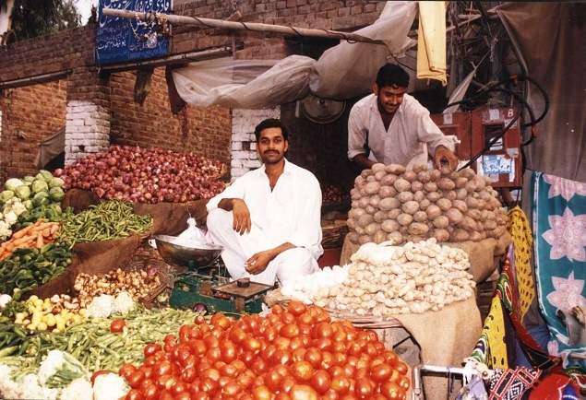
Akhuwat Borrower

Slide 18
OFFICES

Slide 19
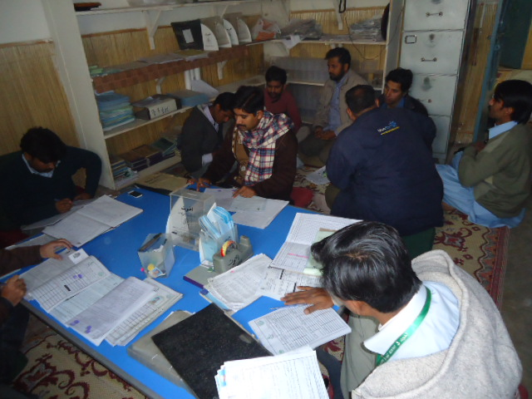
Lahore
Akhuwat Township Branch Staff and Discussion with borrowers

Slide 20
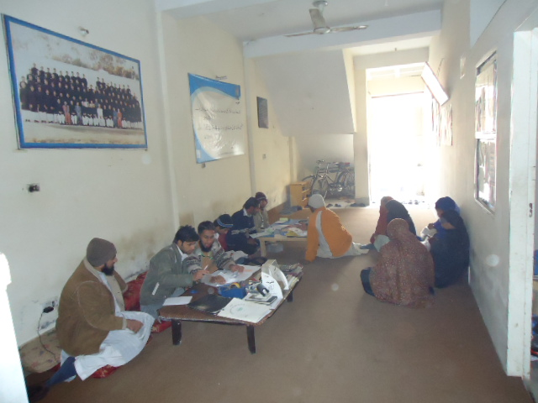
Lahore
Akhuwat Samnabad branch Staff and completion of Application form

Slide 21
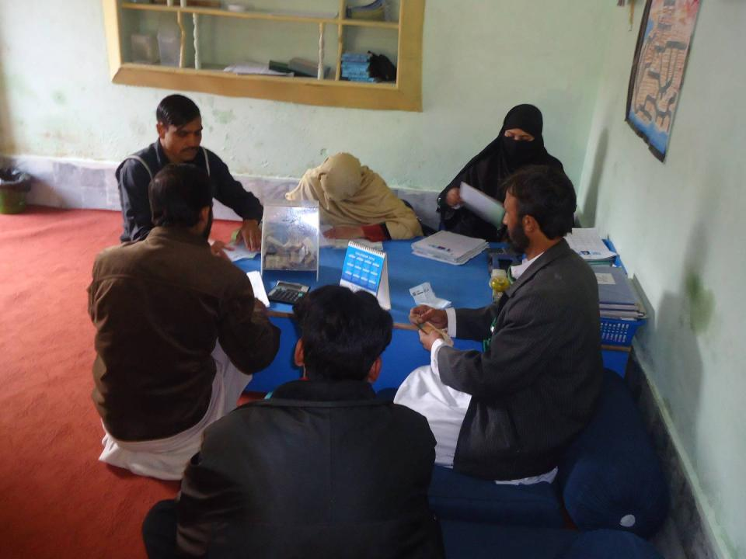
Peshawar
Akhuwat Nowshera Klan branch Staff and completion of Applications

Slide 22
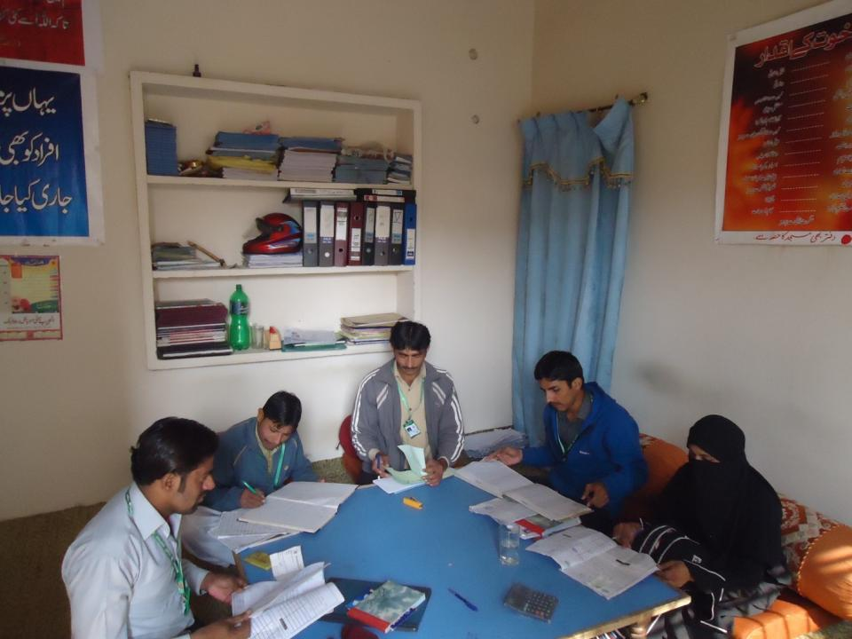
Bahawalpur
Akhuwat Bahawalpur branch Staff and completion of Applications

Slide 23
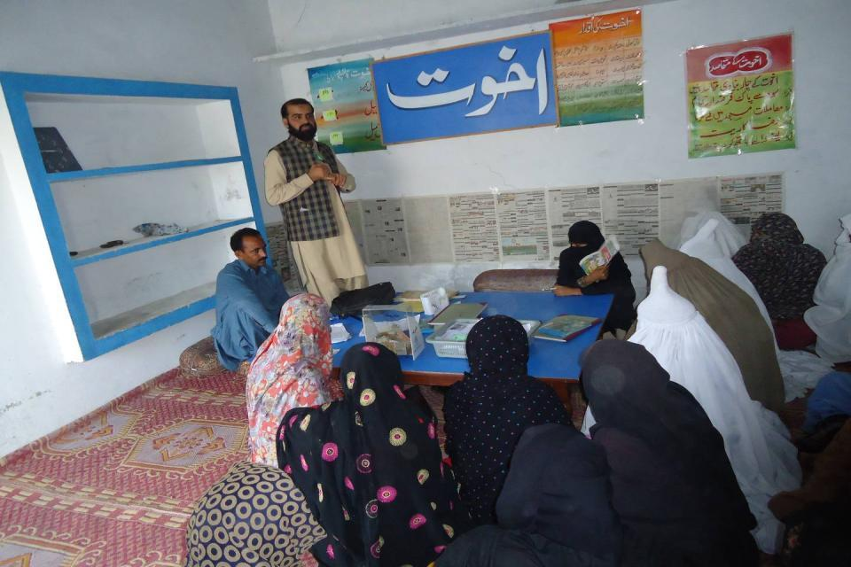
Rajanpur
1,003 | 772 | 231 | 864 | 11,866,000
Area Manager (Rajanpur) Addressing to female borrowers in Akhuwat Fazilpur Branch on disbursement event in November 2011

Slide 24
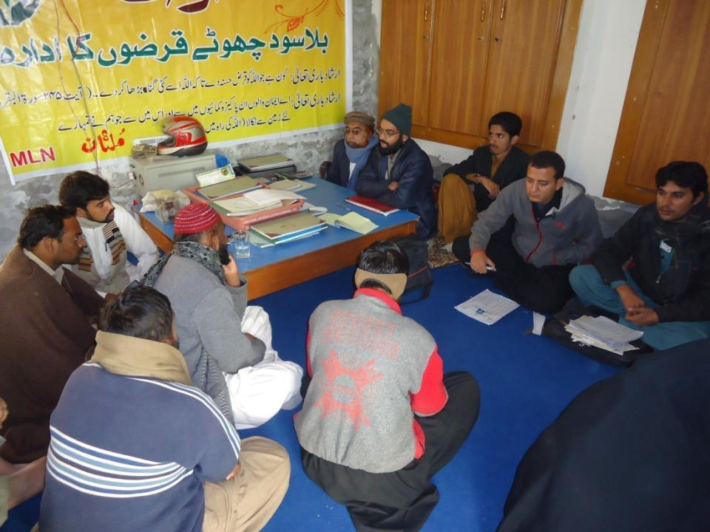
Multan
Akhuwat MULTAN BRANCH Staff and completion of Applications

Slide 25
LOAN DISBURSEMENT METHODOLGY

Slide 26
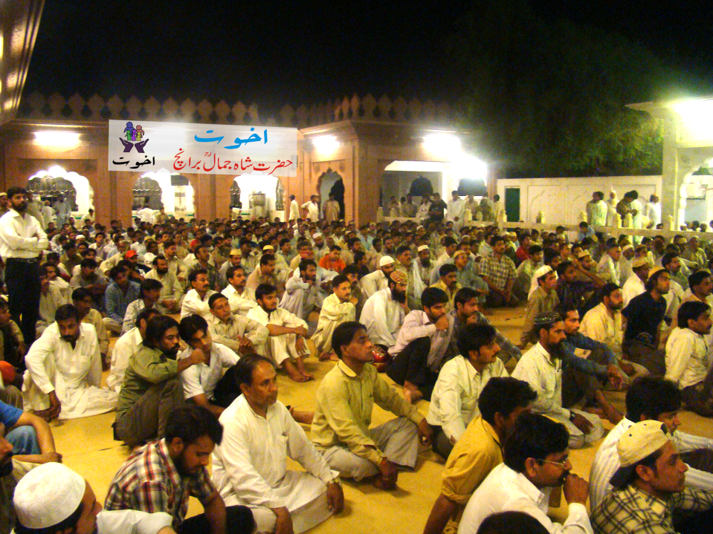
A Loan Disbursement Event in a Mosque

Slide 27
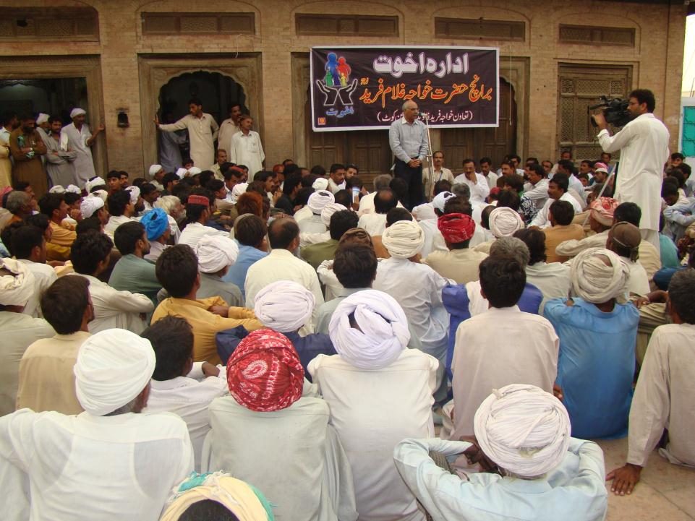
Akhuwat Event in a Mosque (Mithan Kot)

Slide 28
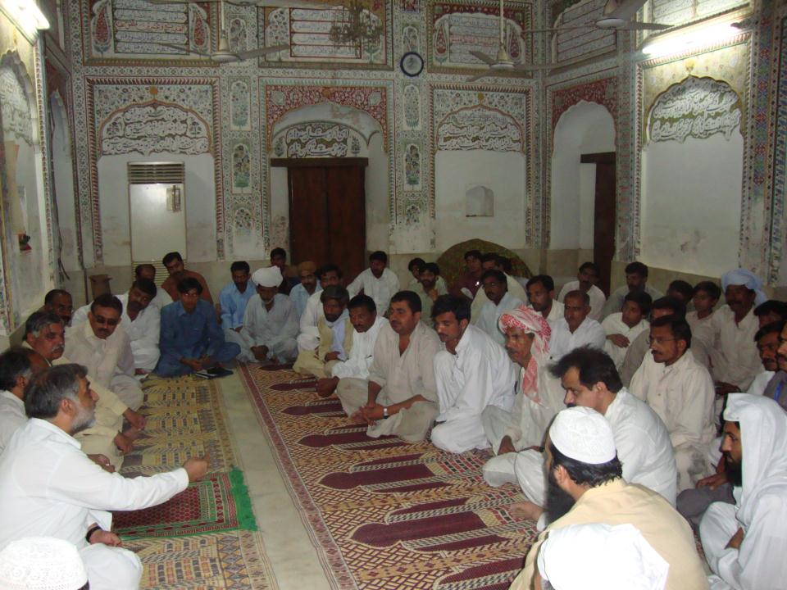
Akhuwat Event in a Mosque (D.G Khan)

Slide 29
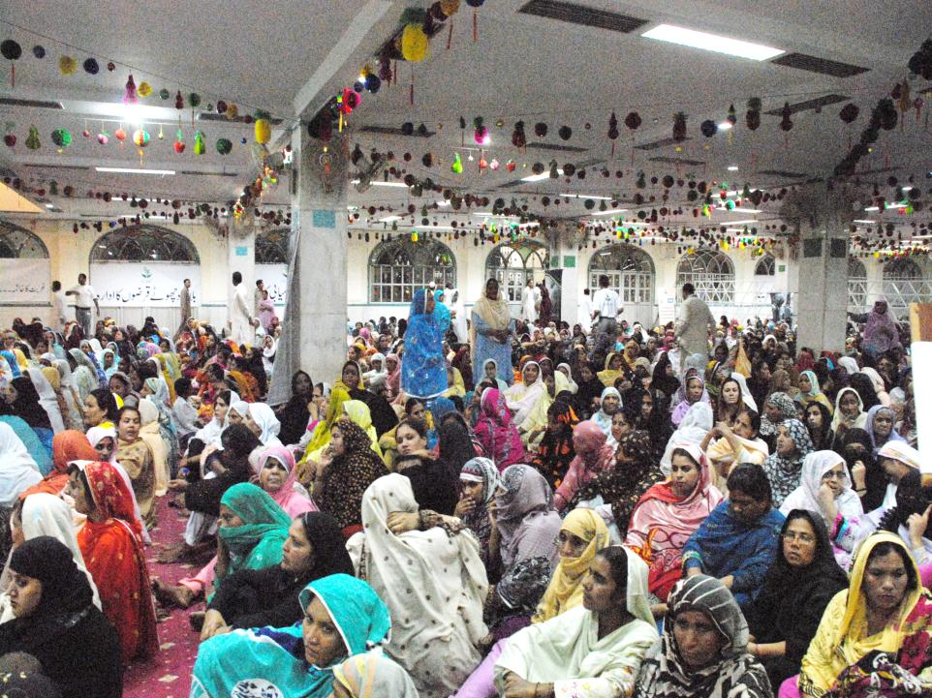
Akhuwat Event in a Mosque (Lahore)

Slide 30
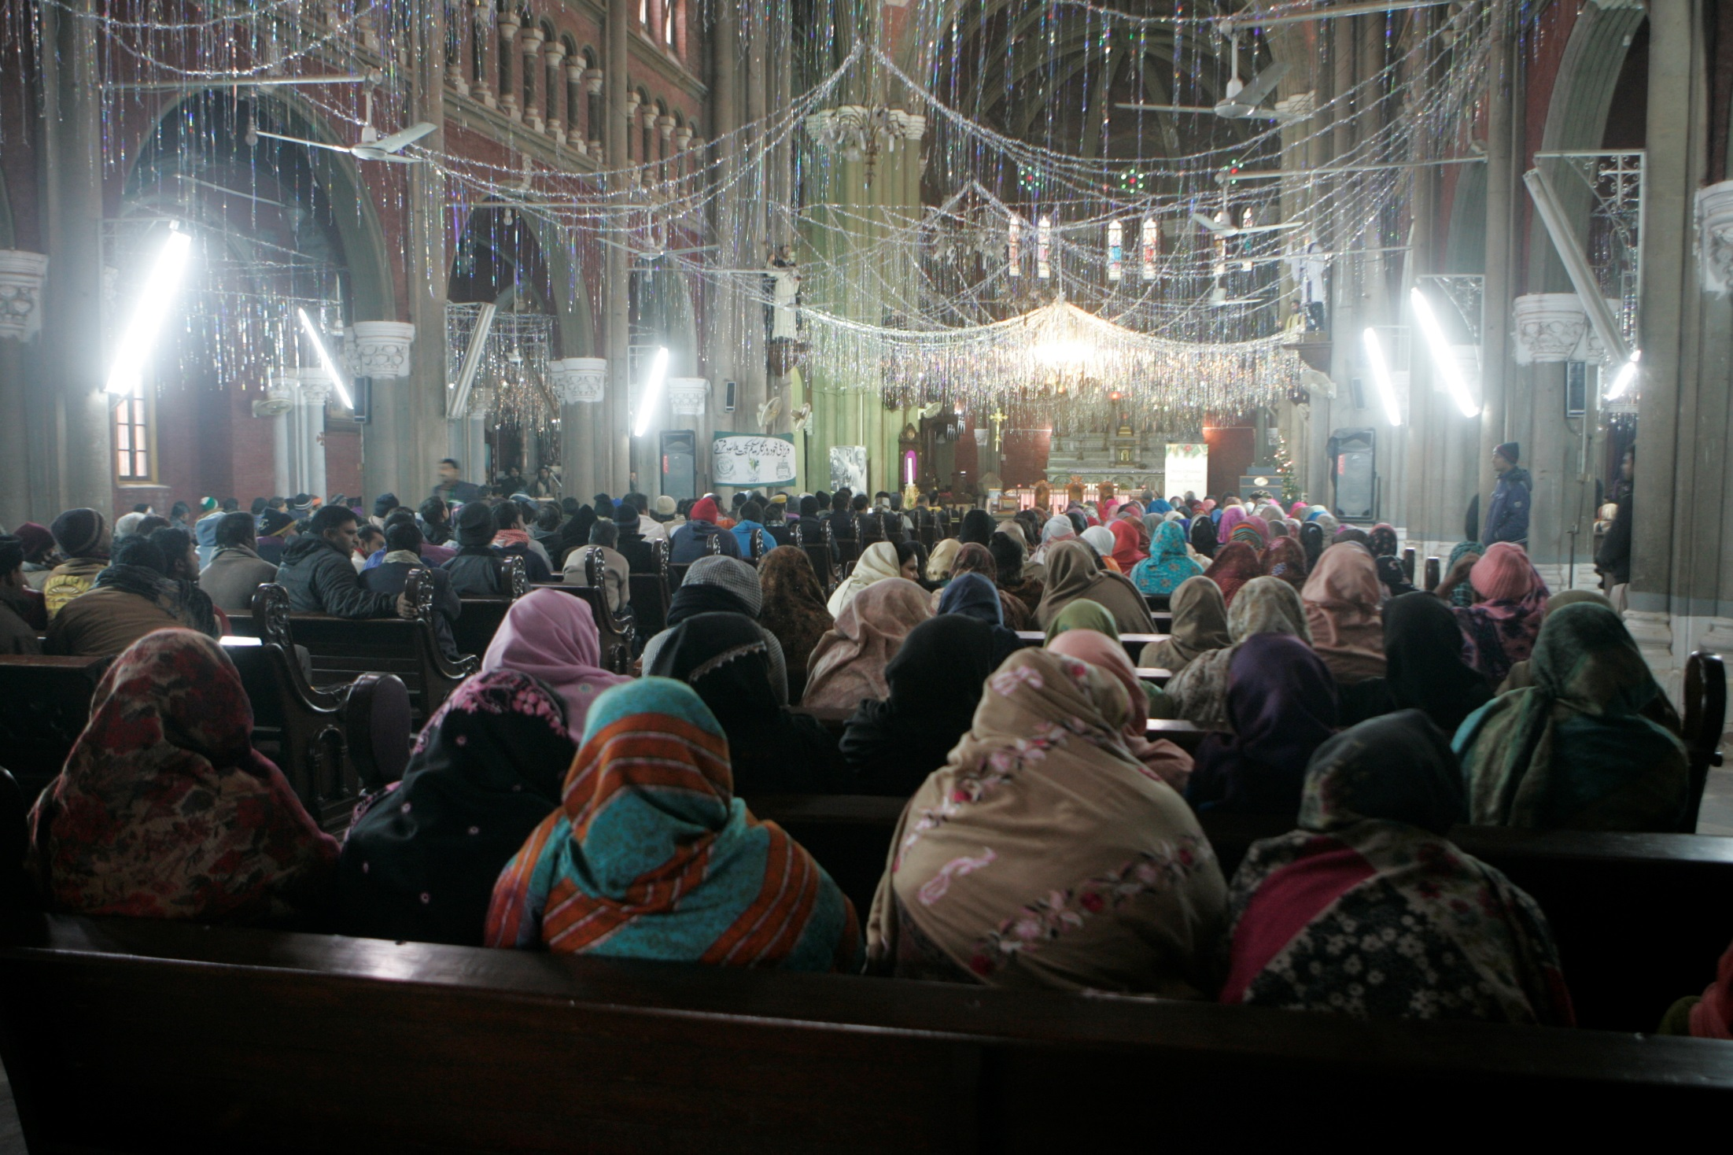
A Loan Disbursement Event in Church, Lahore on 19-12-2014

Slide 31
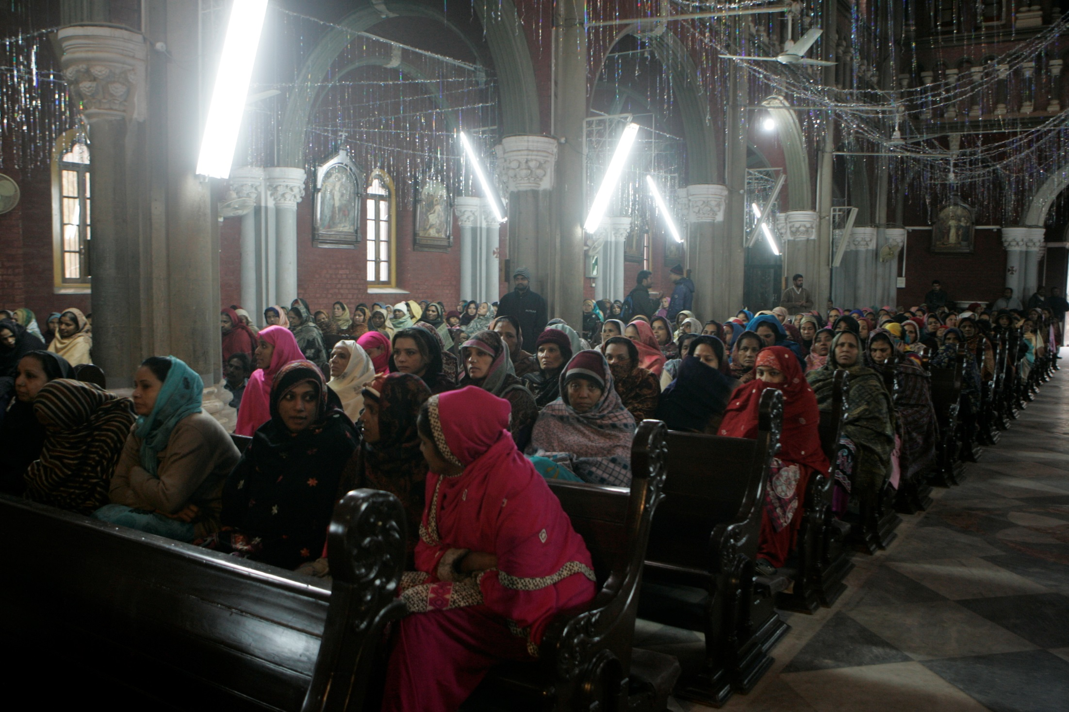
A Loan Disbursement Event in Church, Lahore on 19-12-2014

Slide 32
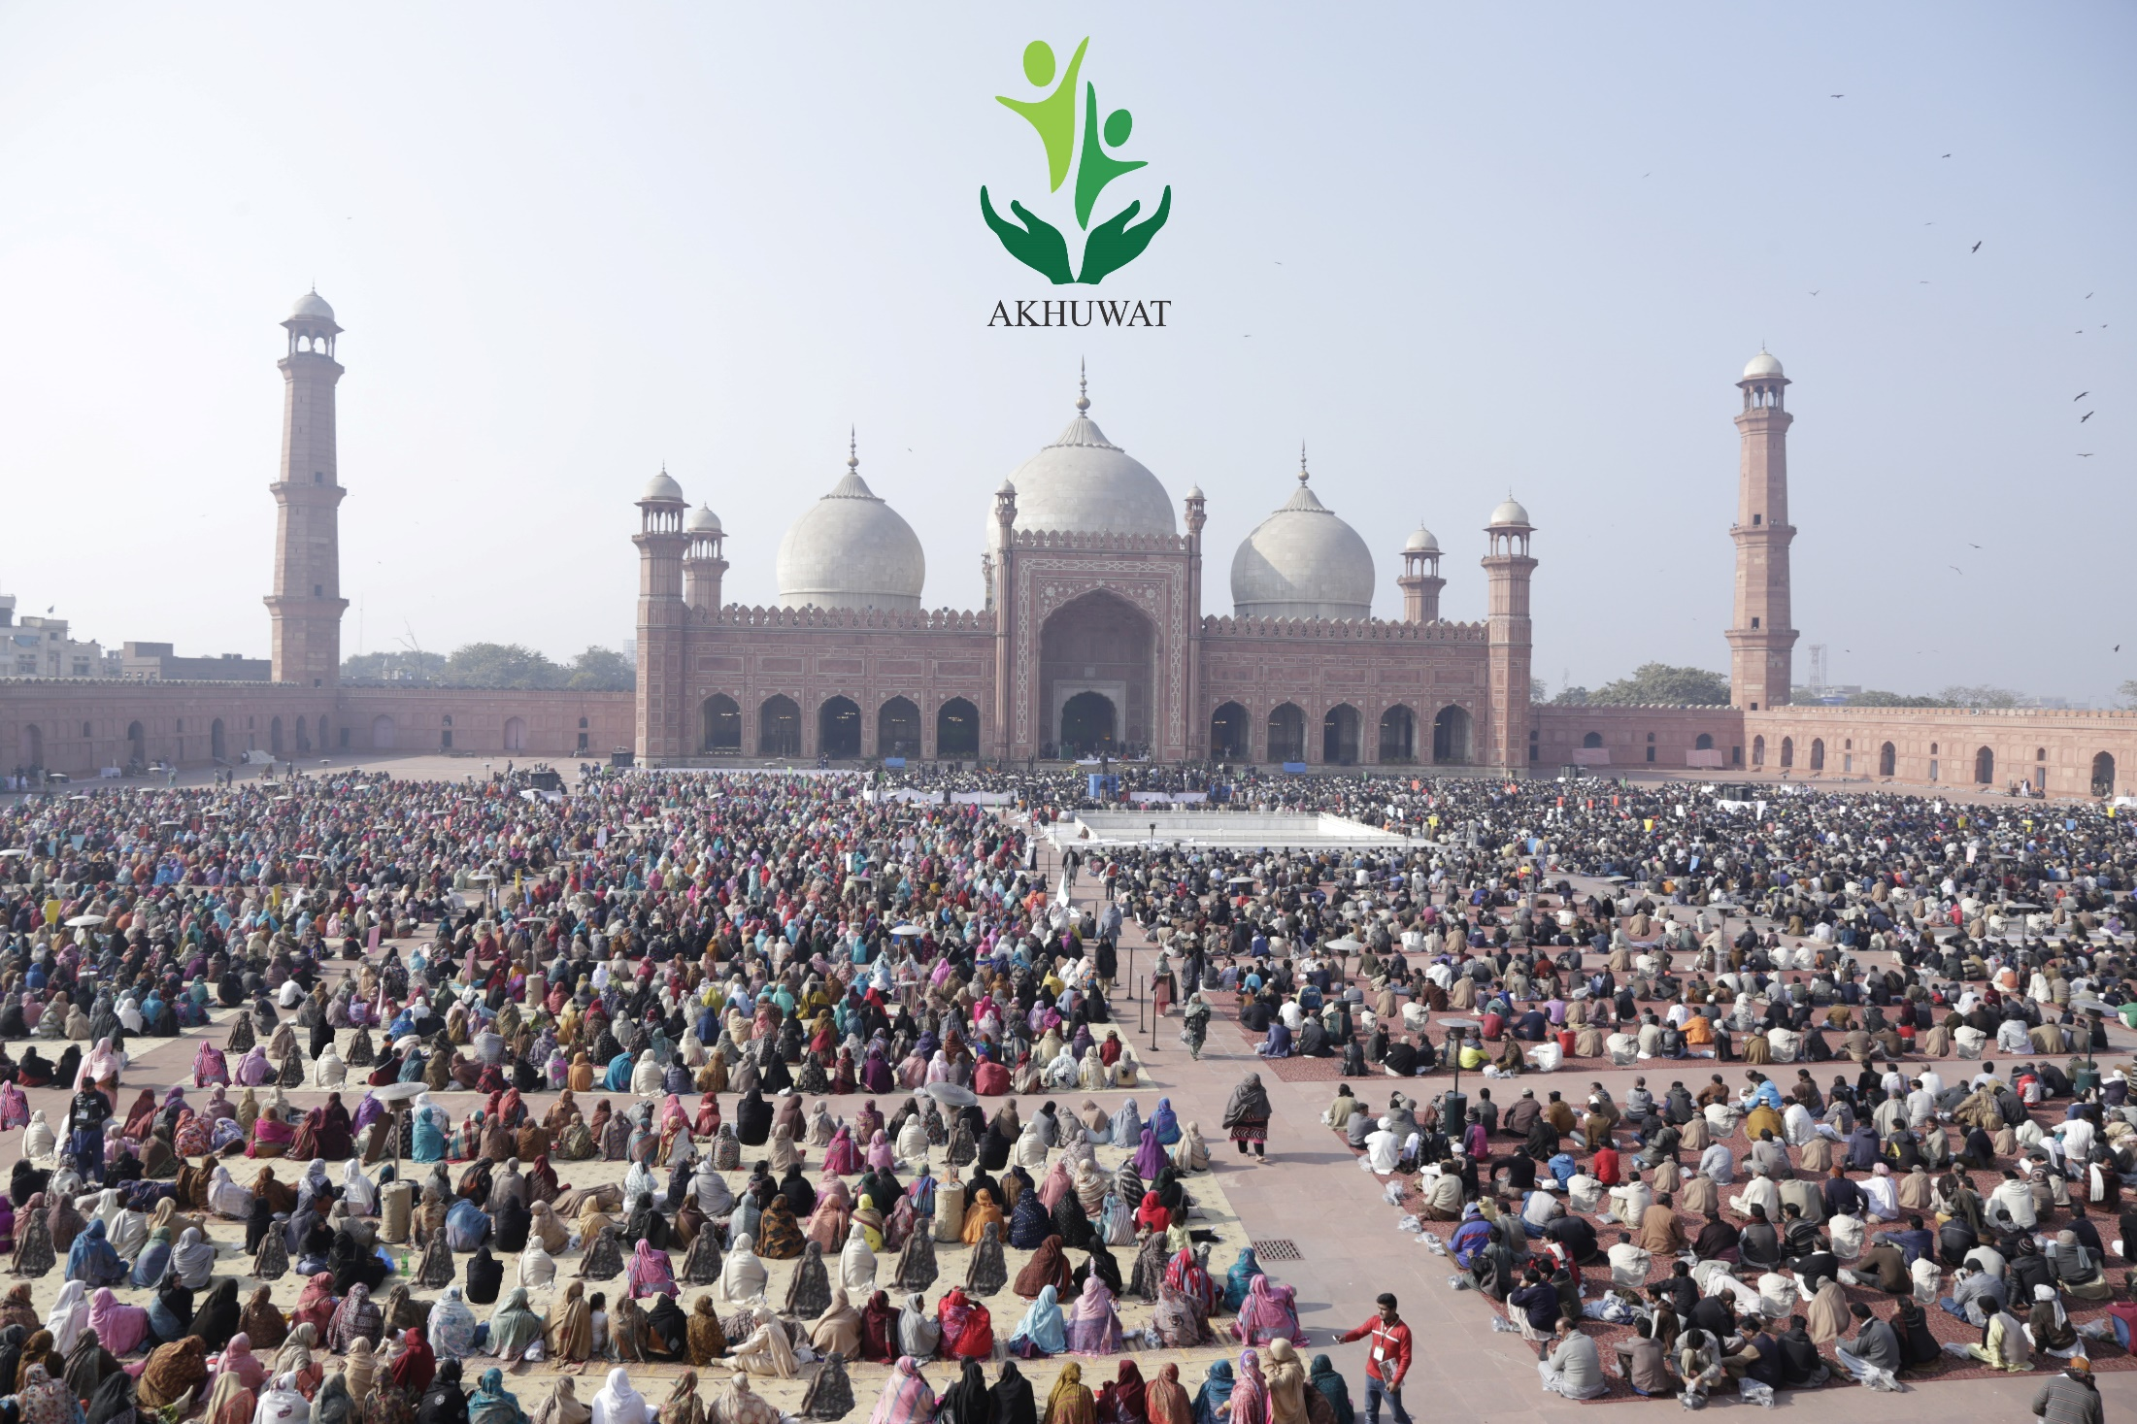
Mega Loan Disbursement Event at Badshahi Mosque, Lahore on 05-01-2016

Slide 33
Cost structure of Loans
Interest : zero
Loan Processing Fee : zero
Profit : zero
Application Fee : US $ 1 to 2 per application Insurance/Takaful : 1% of loan amount (voluntary)

Slide 34
Performance Overview
Started in 2001 with a first donation of US $ 100
Credit Pool now has grown to US $ 180 million
This Pool is a Revolving fund
The amount is regularly disbursed and recovered
Cumulative disbursement is US $ 600 million

Slide 35
Branch Opening
Community Awareness
Loan Approval Committee
Funds Request and Transfer
Disbursement in Mosque/Church
First Visit
Business Appraisal
Application Receiving
2nd Visit & Meeting in Mosque/Church
Monitoring
Recovery
Group/or individual Case Formation
Credit Process

Slide 36
Performance Overview as on 31stMarch, 2018
Total Benefiting Families = 2.56Million
Total Amount Disbursed = USD600Million
Active Loans = 938,233
Number of branches = 800
Number of cities & towns = 380
Number of staff = 4246
Recovery Rate = 99.94%

Slide 37
Progress Overview

Slide 38
Progress Overview

Slide 39
Progress Overview
Year | MDP/Year Rs. | Cumulative Rs. | MDP/Year$ | Cumulative$
2007-2008 | 20,730 | 20,730 | 207 | 207
2008-2009 | 10,338 | 31,068 | 103 | 311
2009-2010 | 6,107,574 | 6,138,642 | 61,076 | 61,386
2010-2011 | 12,258,508 | 18,397,150 | 122,585 | 183,972
2011-2012 | 23,868,857 | 42,266,007 | 238,689 | 422,660
2012-2013 | 54,085,163 | 96,351,170 | 540,852 | 963,512
2013-2014 | 92,469,597 | 188,820,767 | 924,696 | 1,888,208
2014-2015 | 90,000,000 | 278,820,767 | 900,000 | 2,788,208
2015-2016 | 152,373,134 | 431,193,901 | 1,523,731 | 4,311,939
2016-2017 | 230,027,653 | 661,221,554 | 2,300,277 | 6,612,216
2017-2018(Mar-18) | 227,676,509 | 888,898,063 | 2,276,765 | 8,888,981
Notes:
Voluntarily without coercision or force
This proves people are worthy and once thry come out of poverty they would like to share their riches with others

Slide 40
Impact Assessments
Impact Assessment of Microfinance: A Case Study of Akhuwat (2008) by University of Central Punjab
Impact Assessment of Microfinance: A Case Study of Akhuwat (2011) by University of Central Punjab
Special Committee Findings for CMSES (2016)
SROI Analysis of CM Punjab’s Self-Employment Scheme (2016)
Islamic Finance and the Role of Qard-e-Hassan in Enhancing Inclusion: A case study of Akhuwat by Zamir Iqbal & Bushra Shafiq, World Bank & State Bank of Pakistan, ISSN 2305-7394
Impact Assessment: Akhuwat – Lendwithcare – by University of Portsmouth, UK (2015-2017)
LUMS – University of Oxford (2016-2017)
Notes:
Akhuwat is a popluar program as an alternative paradigm. List of case studies

Slide 41
Important Studies - I
Towards a Sustainable Islamic Microfinance Model in Pakistan, 6. May 2014, Salman Ahmed Shaikh, Salman Ahmed Shaikh is pursuing PhD in Economics. National University of Malaysia.
The Collective and the Individual: Re-thinking the Role of Altruism in Institutions Through Akhuwat’s Example, by Natasha Ansari under the Direction of Professor Shahrukh R. Khan, Economics Department Mount Holyoke College, May 2013
Akhuwat: Microloans through Brotherhood A case study on the success of Akhuwat’s Islamic microfinance model, Jelmer David Ikin, Master of Law & Diplomacy, 2013, The Fletcher School, Tufts University.

Slide 42
Important Studies - II
Entrepreneurship and Microfinance- A tool for empowerment of poor- Case of Akhuwat 2008 -Pakistan, School of Sustainable Development of Society and Technology, Malardalen University
Islamic Finance and the Role of Qard-al-Hassan (benevolent loans) in Enhancing Inclusion: a case study of Akhuwat, ACRN Oxford Journal of Finance and Risk Perspectives Special Issue of Social and Sustainable Finance, Vol.4 Issue 4, October 2015, p. 23-40 ISSN 2305-7394, Zamir Iqbal , Bushra Shafiq,
Akhuwat: Fighting Poverty with Interest-Free Microfinance, by Ussama Ahmad Khan, HKS MPP 2016, in collaboration with Dick Cavanagh, Adjunct Lecturer in Public Policy, at the John F. Kennedy School of Government, Harvard University.
Akhuwat: Potential for a Sustainable Islamic Interest Free Microfinance Model (2016), Beall, Juliana S., Scripps Senior Theses. Paper 755.

Slide 43
How to replicate
Introduction of Akhuwat model
Website and promotional material
Training manuals and operational material
Staff training
Visit Akhuwat premises
Continuous technical support

Slide 44
Issues in Replication
Strong Commitment
Financial Resources
Operating at optimum level
Simplicity and keeping costs low
Local conditions
Human Resource

Slide 45
Our Belief
We derive our inspiration from Islam but our message is universal for all
Poverty alleviation is the joint responsibility of the state and the civil society
Equitable distribution of wealth is a pre-requisite
Charity alone is not the answer
Availability of credit/financial inclusion is a must for all
Solidarity with the poor is the way forward

Slide 46
Discussion
Question and Answer Session

